Slide 1
PAGE REPLACEMENT TECHNIQUES IN OS

Slide 2
01
INTRODUCTION
Virtual Memory Management is a critical component of operating systems, where Page Replacement Algorithms play a pivotal role. The primary objective of these algorithms is to minimize the occurrence of page faults, which occur when a program attempts to access a memory page that is not currently in physical memory.
In such cases, the system must find a way to bring the required page into memory, leading to the necessity of page replacement.
When a page fault happens and there are no available free page frames in memory, the system must select a page to evict from memory. This decision is crucial to maintaining system performance and efficiency. By exploring different page replacement policies and strategies, we aim to optimize memory utilization and minimize the impact of page faults on overall system operation. Join us as we delve into the world of page replacement in virtual memory management and understand how these algorithms shape the efficiency of modern operating systems.

Slide 3
PAGE REPLACEMENT
Page Replacement id Required when :
All the frames of the main memory are already occupied.
Thus, a page has to be replaced to create a room for the required page.
FIFO
OPTIMAL
LRU
PAGE REPLACEMENT ALGORITHMS
Page Replacement Algorithms helps to decide which page must be swapped out of the main memory to create a room for the incoming page
FIFO (First In First Out),
Optimal Page Replacement Algorithm.
LRU (Least Recently Used).

Slide 4
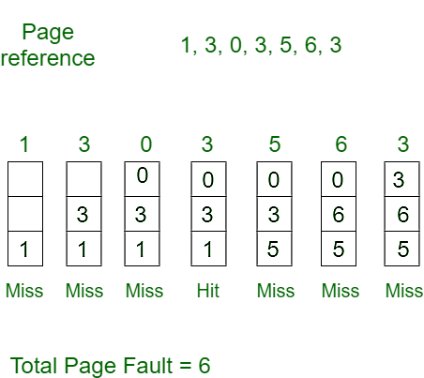
02
ALGORITHM
First In, First Out (FIFO):
This is the simplest page replacement algorithm. In this algorithm, the operating system keeps track of all pages in the memory in a queue, the oldest page is in the front of the queue. When a page needs to be replaced, the page in the front of the queue is selected for removal.
Example 1: Consider page reference string 1, 3, 0, 3, 5, 6, 3 with 3-page frames. Find the number of page faults.
Initially, all slots are empty, so when 1, 3, 0 came they are allocated to the empty slots —> 3 Page Faults. when 3 comes, it is already in memory so —> 0 Page Faults. Then 5 comes, it is not available in memory so it replaces the oldest page slot i.e 1. —>1 Page Fault. 6 comes, it is also not available in memory so it replaces the oldest page slot i.e 3 —>1 Page Fault. Finally, when 3 come it is not available so it replaces 0 1 page fault.

Slide 5
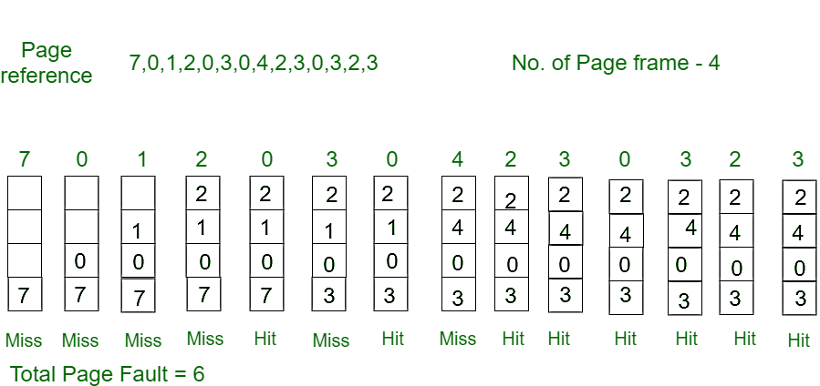
2. Optimal Page replacement:
In this algorithm, pages are replaced which would not be used for the longest duration of time in the future.
Example-2: Consider the page references 7, 0, 1, 2, 0, 3, 0, 4, 2, 3, 0, 3, 2, 3 with 4 page frame. Find number of page fault.
Initially, all slots are empty, so when 7 0 1 2 are allocated to the empty slots —> 4 Page faults 0 is already there so —> 0 Page fault. when 3 came it will take the place of 7 because it is not used for the longest duration of time in the future.—>1 Page fault.
0 is already there so —> 0 Page fault. 4 will takes place of 1 —> 1 Page Fault.

Slide 6
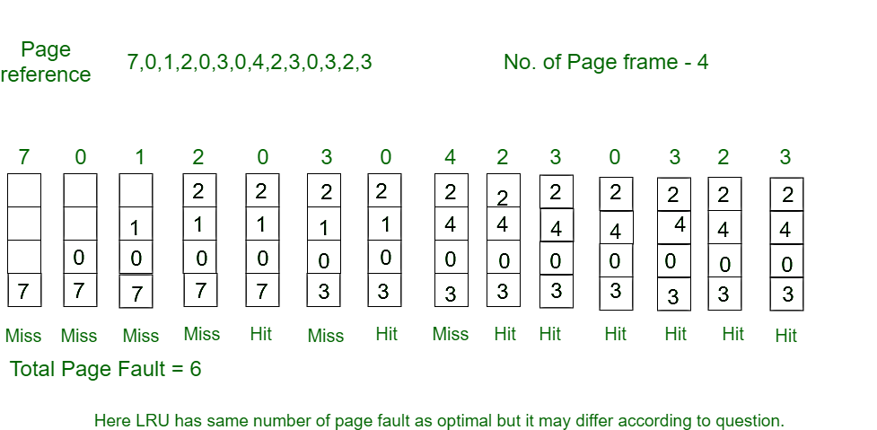
3. Least Recently Used:
In this algorithm, page will be replaced which is least recently used.
Example-3: Consider the page reference string 7, 0, 1, 2, 0, 3, 0, 4, 2, 3, 0, 3, 2, 3 with 4 page frames. Find number of page faults.
Initially, all slots are empty, so when 7 0 1 2 are allocated to the empty slots —> 4 Page faults 0 is already their so —> 0 Page fault. when 3 came it will take the place of 7 because it is least recently used —>1 Page fault 0 is already in memory so —> 0 Page fault. 4 will takes place of 1 —> 1 Page Fault

Slide 7
03
CODE
#include <stdio.h>
int main()
{
int referenceString[10], pageFaults = 0, m, n, s, pages, frames;
printf("\nEnter the number of Pages:\t");
scanf("%d", &pages);
printf("\nEnter reference string values:\n");
for( m = 0; m < pages; m++)
{
printf("Value No. [%d]:\t", m + 1);
scanf("%d", &referenceString[m]);
}
printf("\n What are the total number of frames:\t");
{
scanf("%d", &frames);
}
int temp[frames];
for(m = 0; m < frames; m++)
{
temp[m] = -1;
}
for(m = 0; m < pages; m++)
{
S= 0;
for(n = 0; n < frames; n++)
{
if(referenceString[m] == temp[n])
{
s++;
pageFaults--;
}
}
pageFaults++;
if((pageFaults <= frames) && (s == 0))
{
temp[m] = referenceString[m];
}
else if(s == 0)
{
temp[(pageFaults - 1) % frames] = referenceString[m];
}
printf("\n");
for(n = 0; n < frames; n++)
{
printf("%d\t", temp[n]);
}
}
printf("\nTotal Page Faults:\t%d\n", pageFaults);
return 0;
}

Slide 8
THANK YOU

